Slide 1
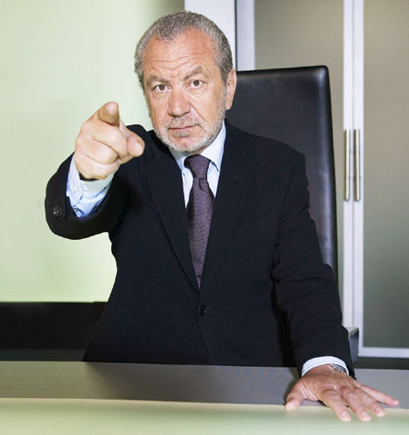
Who am I … ? How much money have I made… ?
Sir Alan Sugar

Slide 2
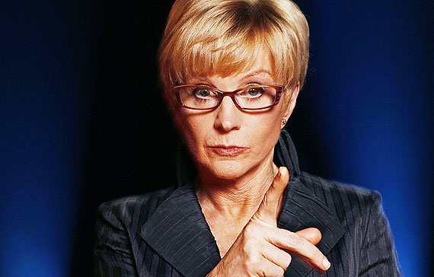
Who am I … ? How much money have I made… ?
Anne Robinson

Slide 3
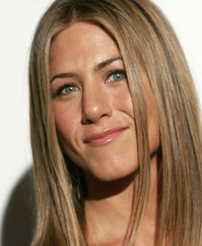
Who am I … ? How much money have I made… ?
Jennifer Aniston

Slide 4
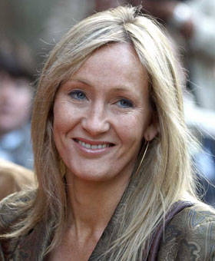
Who am I … ? How much money have I made… ?
J K Rowling

Slide 5
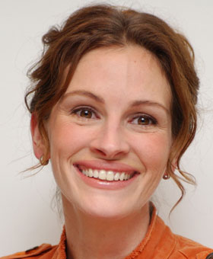
Who am I … ? How much money have I made… ?
Julia Roberts

Slide 6
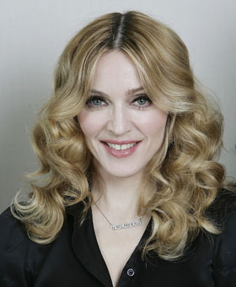
Who am I … ? How much money have I made… ?
Madonna

Slide 7
Who am I … ? How much money have I made… ?
Mariah Carey

Slide 8
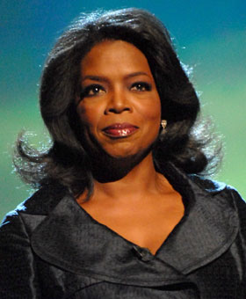
Who am I … ? How much money have I made… ?
Oprah Winfrey

Slide 9
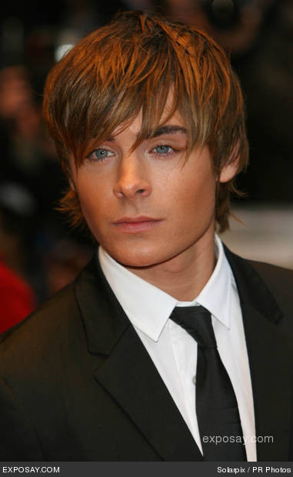
Who am I … ? How much money have I made… ?
Zac Efron

Slide 10
Who am I … ? How much money have I made… ?
Jennifer Lopez

Slide 11
Millionaires
£1,688
£135
£85
£730
£60
£560
£69
£6
£68
£300

Slide 12
Place value and ordering
WALT:
Understand place value and use it to
order numbers
Keywords:
Place value
Ascending
Descending

Slide 13
What is the value of the underlined digit in each number?
5 476
11 082
259 661
17.94
3.1412

Slide 14
Ordering
Knowing the value of each digit in a number can help us put them in order.
Put the following lists of numbers in ascending order:
30 300 3033 3000 3003 2998
56 762 59 342 56 745 56 321

Slide 15
Ordering Decimals
Put the following numbers in ascending order
3.069 5.2 3.4 3.08 3.0901
Method 1: consider the value of the digits
3.069 5.2 3.4 3.08 3.0901
We can see that 5.2 is the largest , but the rest of the numbers have 3 units… what can we do next?
3.069 3.4 3.08 3.0901 5.2
Look at the next digit along!
Keep repeating this process until all the numbers are in order.

Slide 16
3.069 3.08 3.0901 3.4 5.2
3.069 3.08 3.0901 3.4 5.2
These are in order already… all done!
Answer:
3.069 3.08 3.0901 3.4 5.2

Slide 17
Method 2: make all the decimals the same length so you can compare them easily
3.069 5.2 3.4 3.08 3.0901
Re-write them as a list…
3.069
5.2
3.4
3.08
3.0901
Re-write them as a list…
3.0690
5.2000
3.4000
3.0800
3.0901
…then fill the gaps with zeros
This makes the decimal parts easier to compare!

Slide 18
Hundreds
Thousands
Tens
Units
4
0
0
Four hundred
5
2
8
0
Five thousand two hundred and
eighty
2
1
5
2
7
9

Slide 19
Hundreds
Thousands
Hundreds
Tens
Units
Thousands
Tens
Units
4
0
0
5
2
8
0
5
2
8
0
5
2
7
9
2
1
4
0
0
5
2
7
9
2
1

Slide 20
£60
£770
£68
£85
£1,688
Millionaires
£6
£300
£560
£69
£135

